Slide 1

Deep CV 101
Burness.Duan
UCloud

Slide 2
Outline
Deep CV Classical Models
Deep CV Applications
Distributed Deep Learning In UCloud

Slide 3
Deep CV Classical Models
LeNet
AlexNet
GoogLeNet
VGG
Deep Residual Network
Notes:
1.LeNet
2.AlexNet
3.GoogLeNet
4.VGG
5.Deep Residual Network

Slide 4
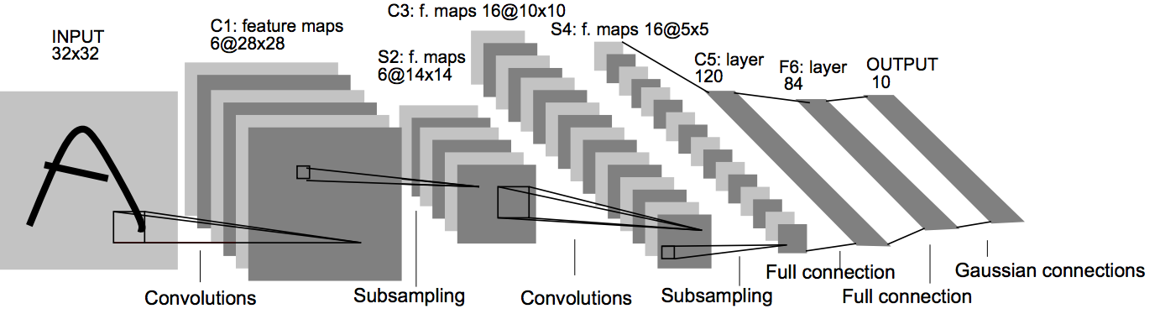
LeNet
LeCun Y, Bottou L, Bengio Y, et al. Gradient-based learning applied to document recognition[J]. Proceedings of the IEEE, 1998, 86(11): 2278-2324.
Notes:
Input:32*32
C1:5*5*6(5*5的卷积核大小，6个channel)，28*28*6
S2:下采样，max-pool，2*2，14*14*6
C3:5*5*16(5*5的卷积核大小，16个channel)，10*10*16
S4:下采样，max-pool，2*2，5*5*16
C5:5*5*120(5*5的卷积核大小，120个channel)，1*1*120
F6:120*84
Output:84*10

Slide 5

LeNet
https://github.com/spark-mler/WorkWithTensorflow/blob/master/CV_model/lenet/lenet.py·
Notes:
Input:32*32
C1:5*5*6(5*5的卷积核大小，6个channel)，28*28*6
S2:下采样，max-pool，2*2，14*14*6
C3:5*5*16(5*5的卷积核大小，16个channel)，10*10*16
S4:下采样，max-pool，2*2，5*5*16
C5:5*5*120(5*5的卷积核大小，120个channel)，1*1*120
F6:120*84
Output:84*10

Slide 6
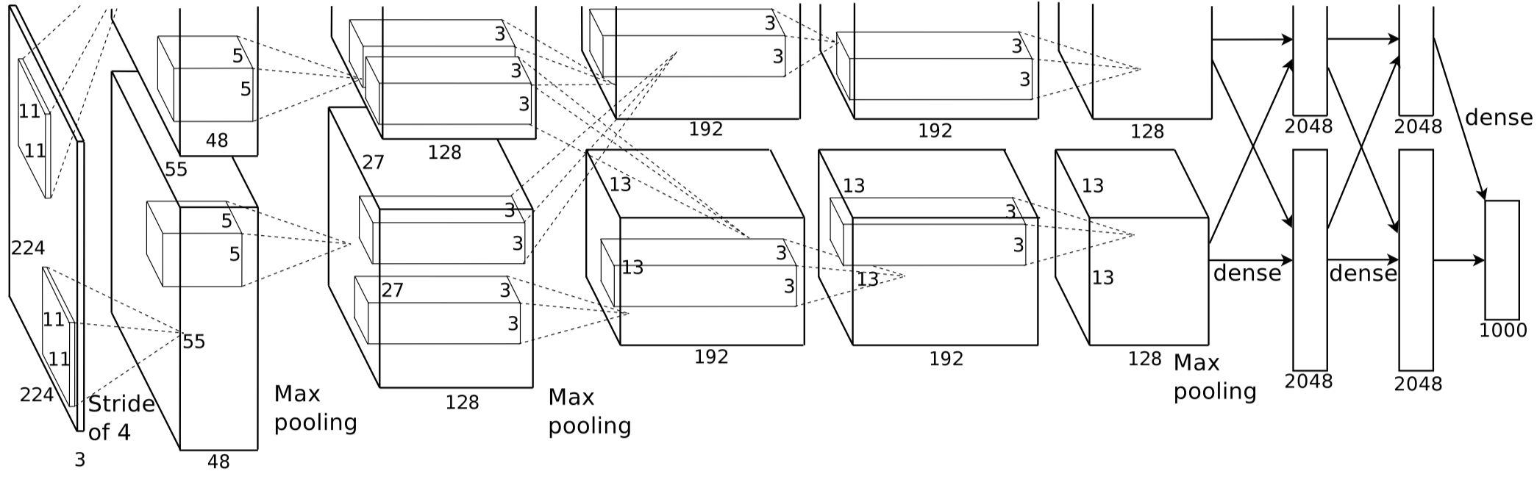
AlexNet
Krizhevsky A, Sutskever I, Hinton G E. Imagenet classification with deep convolutional neural networks[C]//Advances in neural information processing systems. 2012: 1097-1105.
Notes:
第一层卷积层 输入图像为227*227*3(paper上貌似有点问题224*224*3)的图像，使用了96个kernels（96,11,11,3），以4个pixel为一个单位来右移或者下移，能够产生55*55个卷积后的矩形框值，然后进行response-normalized（其实是Local Response Normalized，后面我会讲下这里）和pooled之后，pool这一层好像caffe里面的alexnet和paper里面不太一样，alexnet里面采样了两个GPU，所以从图上面看第一层卷积层厚度有两部分，池化pool_size=(3,3),滑动步长为2个pixels，得到96个27*27个feature。
第二层卷积层使用256个（同样，分布在两个GPU上，每个128kernels（5*5*48）），做pad_size(2,2)的处理，以1个pixel为单位移动（感谢网友指出），能够产生27*27个卷积后的矩阵框，做LRN处理，然后pooled，池化以3*3矩形框，2个pixel为步长，得到256个13*13个features。
第三层、第四层都没有LRN和pool，第五层只有pool，其中第三层使用384个kernels（3*3*256，pad_size=(1,1),得到256*15*15，kernel_size为（3，3),以1个pixel为步长，得到384*13*13）；第四层使用384个kernels（pad_size(1,1)得到256*15*15，核大小为（3，3）步长为1个pixel，得到384*13*13）；第五层使用256个kernels（pad_size(1,1)得到384*15*15，kernel_size(3,3)，得到256*13*13，pool_size(3，3）步长2个pixels，得到256*6*6）。
全连接层： 前两层分别有4096个神经元，最后输出softmax为1000个（ImageNet），注意caffe图中全连接层中有relu、dropout、innerProduct。

Slide 7
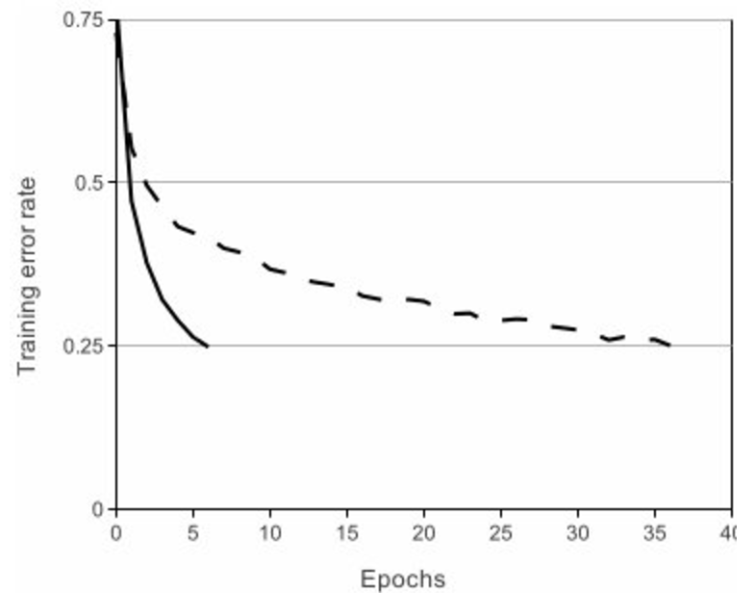
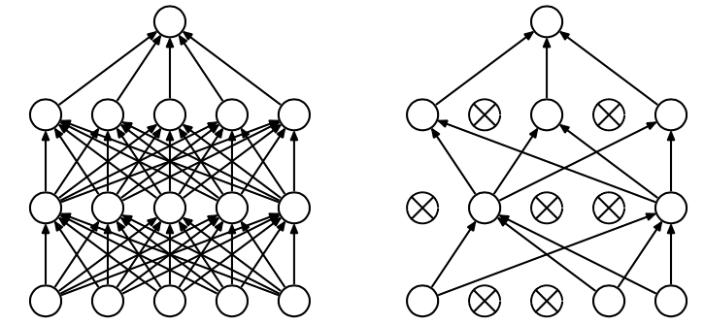
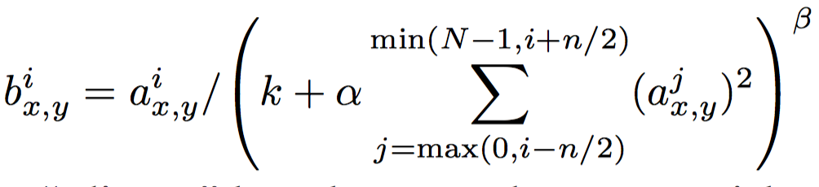
AlexNet Tricks
ReLU on CIFAR-10
Local Response Normalization
Dropout
Notes:
基于CIFAR-10的四层卷积网络在tanh和ReLU达到25%的training error的迭代次数
使用ReLU f(x)=max(0,x)后，你会发现激活函数之后的值没有了tanh、sigmoid函数那样有一个值域区间，所以一般在ReLU之后会做一个normalization，LRU就由文中提出（这里不确定，应该是提出？）一种方法，在神经科学中有个概念叫“Lateral inhibition”，讲的是活跃的神经元对它周边神经元的影响
Response normalization reduces our top-1 and top-5 error rates by 1.4% and 1.2%

Slide 8
AlexNet
Notes:
基于CIFAR-10的四层卷积网络在tanh和ReLU达到25%的training error的迭代次数
使用ReLU f(x)=max(0,x)后，你会发现激活函数之后的值没有了tanh、sigmoid函数那样有一个值域区间，所以一般在ReLU之后会做一个normalization，LRU就由文中提出（这里不确定，应该是提出？）一种方法，在神经科学中有个概念叫“Lateral inhibition”，讲的是活跃的神经元对它周边神经元的影响
Response normalization reduces our top-1 and top-5 error rates by 1.4% and 1.2%

Slide 9
GoogLeNet
Shortcoming
Bigger size means a larger number of parameters, which makes the enlarged network more prone to over-ﬁtting
Increased network size is the dramatically increased use of computational resources
Computing infrastructures are very inefﬁcient when it comes to numerical calculation on non-uniform sparse data structures.
Szegedy C, Liu W, Jia Y, et al. Going deeper with convolutions[C]//Proceedings of the IEEE Conference on Computer Vision and Pattern Recognition. 2015: 1-9.

Slide 10
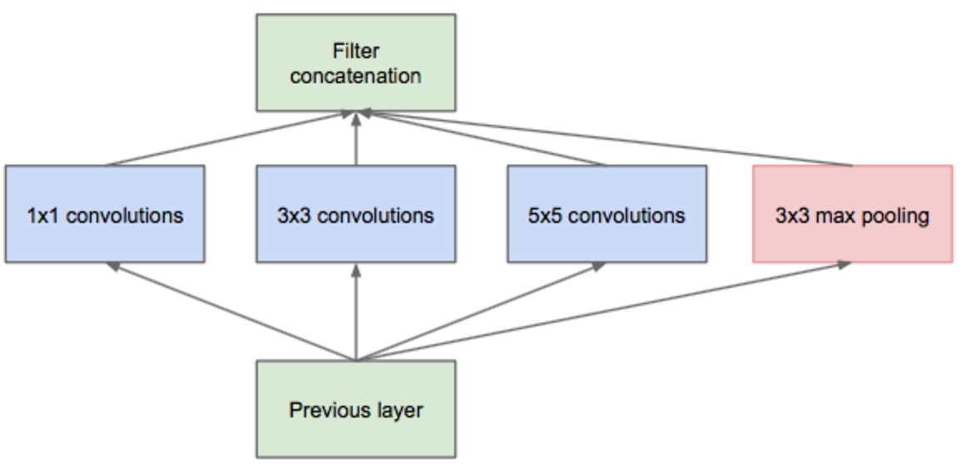
GoogLeNet
Inception Module
Notes:
Inception module的提出主要考虑多个不同size的卷积核能够hold图像当中不同cluster的信息，为方便计算，paper中分别使用1*1，3*3，5*5，同时加入3*3 max pooling模块。 然而这里存在一个很大的计算隐患，每一层Inception module的输出的filters将是分支所有filters数量的综合，经过多层之后，最终model的数量将会变得巨大，naive的inception会对计算资源有更大的依赖。

Slide 11
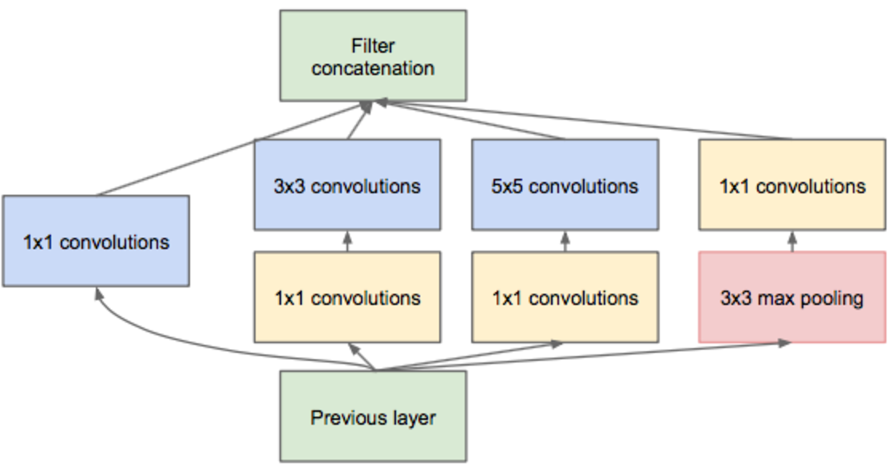
GoogLeNet
Inception Module With Dimension Reduction
Lin M, Chen Q, Yan S. Network in network[J]. arXiv preprint arXiv:1312.4400, 2013.
Notes:
Inception module的提出主要考虑多个不同size的卷积核能够hold图像当中不同cluster的信息，为方便计算，paper中分别使用1*1，3*3，5*5，同时加入3*3 max pooling模块。 然而这里存在一个很大的计算隐患，每一层Inception module的输出的filters将是分支所有filters数量的综合，经过多层之后，最终model的数量将会变得巨大，naive的inception会对计算资源有更大的依赖。
前面我们有提到Network-in-Network模型，1*1的模型能够有效进行降维（使用更少的来表达尽可能多的信息），所以文章提出了”Inception module with dimension reduction”,在不损失模型特征表示能力的前提下，尽量减少filters的数量，达到减少model复杂度的目的：

Slide 12
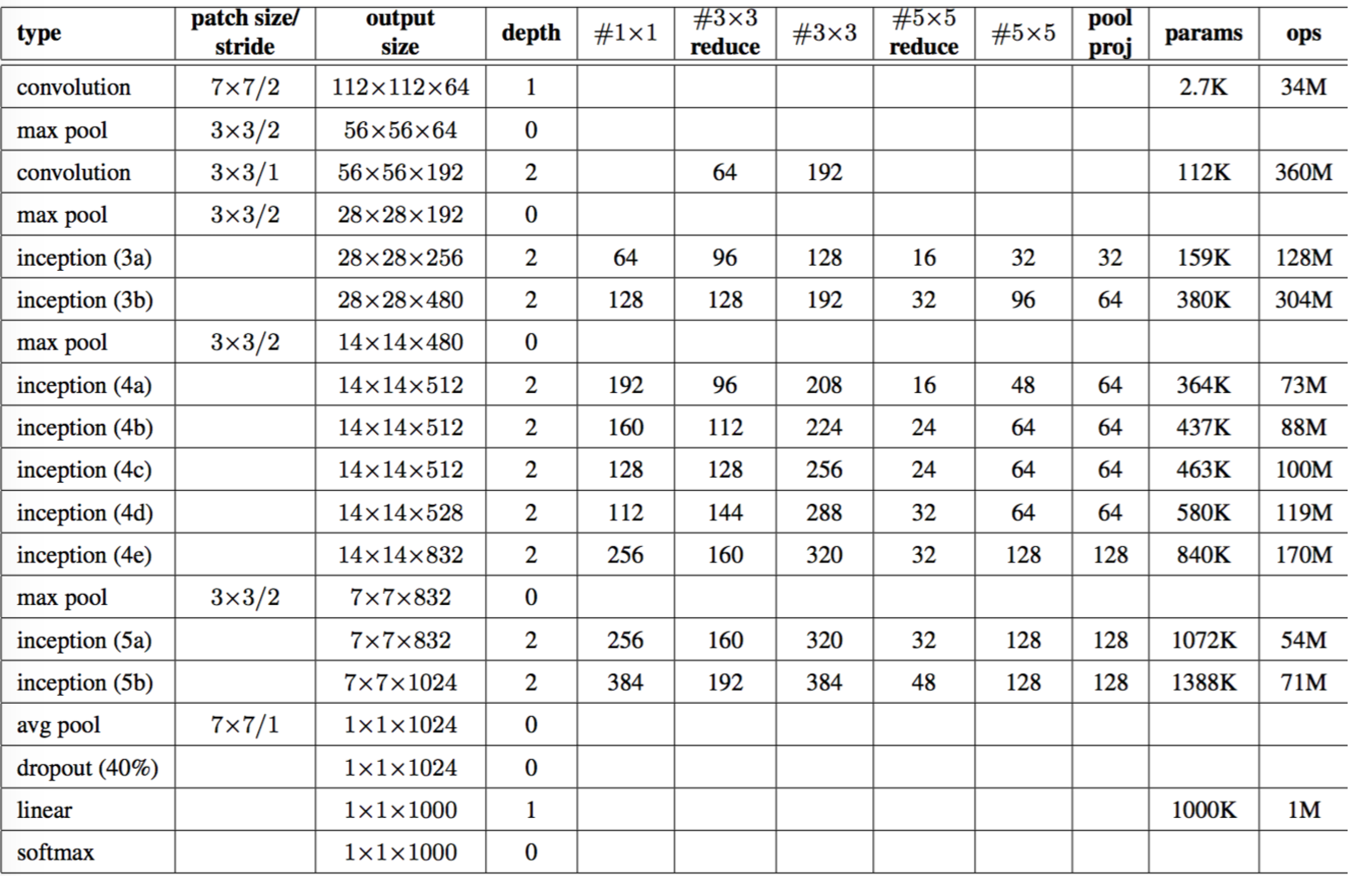
GoogLeNet
Overall of GoogLeNet

Slide 13
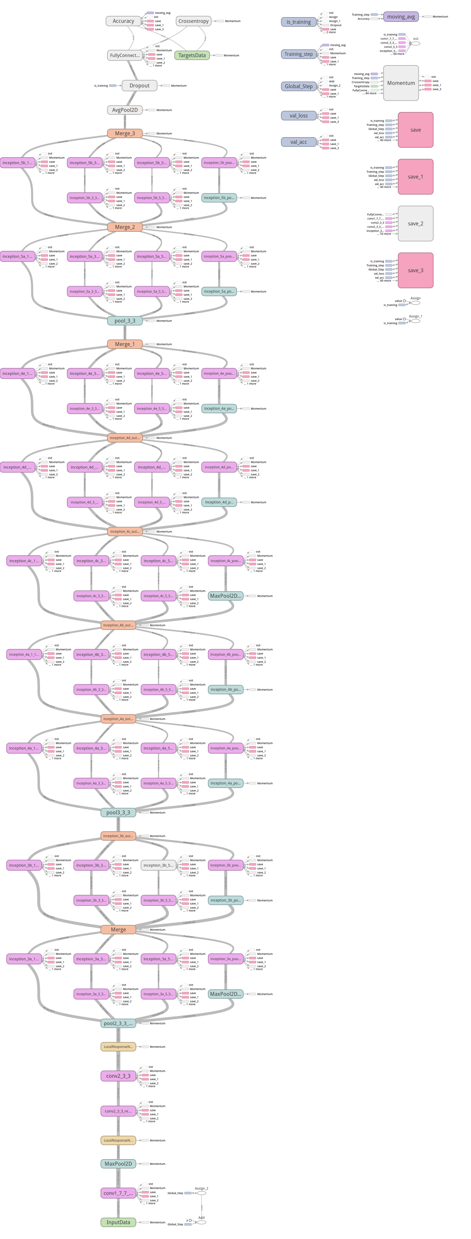
GoogLeNet
GoogLeNet With TFlearn
https://github.com/tflearn/tflearn/blob/master/examples/images/googlenet.py
Notes:
Bug: 用chrome download graph png时是空白的，换成火狐是可以的

Slide 14
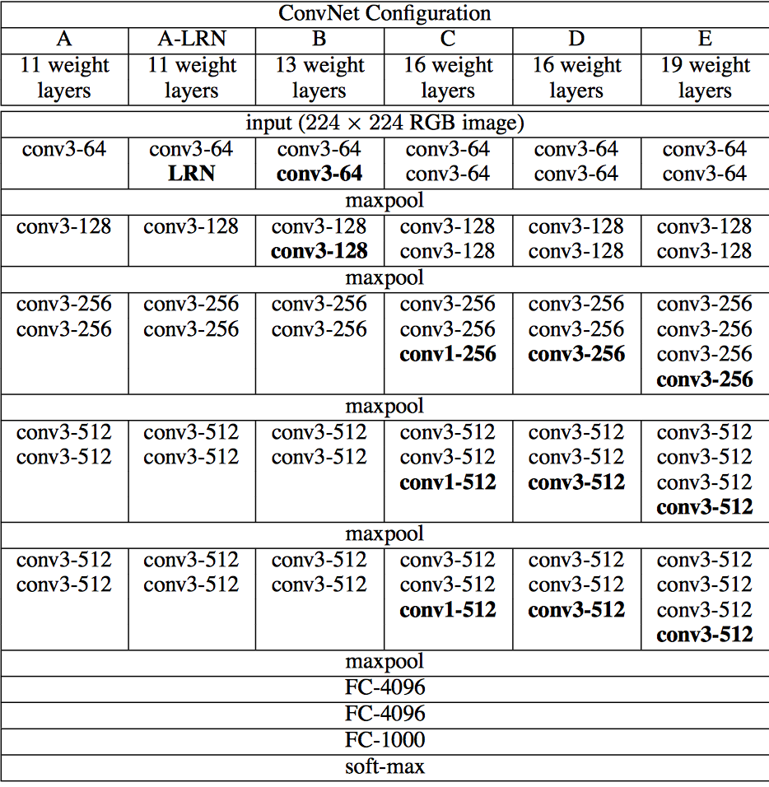
VGG
VGG With TFlearn
network = input_data(shape=[None, 224, 224, 3])
network = conv_2d(network, 64, 3, activation='relu')
network = conv_2d(network, 64, 3, activation='relu')
network = max_pool_2d(network, 2, strides=2)
network = conv_2d(network, 128, 3, activation='relu')
network = conv_2d(network, 128, 3, activation='relu')
network = max_pool_2d(network, 2, strides=2)
network = conv_2d(network, 256, 3, activation='relu')
network = conv_2d(network, 256, 3, activation='relu')
network = conv_2d(network, 256, 3, activation='relu')
network = max_pool_2d(network, 2, strides=2)
network = conv_2d(network, 512, 3, activation='relu')
network = conv_2d(network, 512, 3, activation='relu')
network = conv_2d(network, 512, 3, activation='relu')
network = max_pool_2d(network, 2, strides=2)
network = conv_2d(network, 512, 3, activation='relu')
network = conv_2d(network, 512, 3, activation='relu')
network = conv_2d(network, 512, 3, activation='relu')
network = max_pool_2d(network, 2, strides=2)
network = fully_connected(network, 4096, activation='relu')
network = dropout(network, 0.5)
network = fully_connected(network, 4096, activation='relu')
network = dropout(network, 0.5)
network = fully_connected(network, 17, activation='softmax')
network = regression(network, optimizer=‘rmsprop’, loss=‘categorical_crossentropy’ ,learning_rate=0.001)
Notes:
VGGnet是Oxford的Visual Geometry Group的team，在ILSVRC 2014上的相关工作，主要工作是证明了增加网络的深度能够在一定程度上影响网络最终的性能，如下图，文章通过逐步增加网络深度来提高性能，虽然看起来有一点小暴力，没有特别多取巧的，但是确实有效，很多pretrained的方法就是使用VGG的model（主要是16和19），VGG相对其他的方法，参数空间很大，最终的model有500多m，alnext只有200m，googlenet更少，所以train一个vgg模型通常要花费更长的时间，所幸有公开的pretrained model让我们很方便的使用

Slide 15
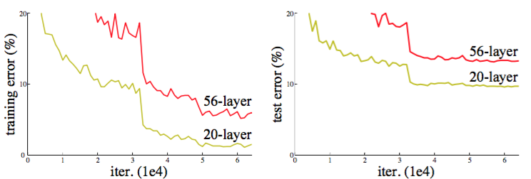
Deep Residual Network
with the network depth increasing, accuracy gets saturated (which might be unsurprising) and then degrades rapidly and such degradation is not caused by overfitting
Notes:
, and adding more layers to a suitably deep model leads to higher training error, as reported in [11, 42] and thoroughly verified by our experiments. Fig. 1 shows a typical example.
The existence of this constructed solution indicates that a deeper model should produce no higher training error than its shallower counterpart. But experiments show that our current solvers on hand are unable to ﬁnd solutions that

Slide 16
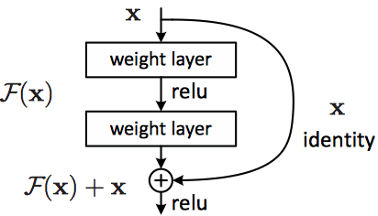
Deep Residual Network
def residual_block(incoming, nb_blocks, out_channels, downsample=False, downsample_strides=2, activation=‘relu’, batch_norm=True, bias=True, weights_init=‘variance_scaling’, bias_init=‘zeros’, regularizer=‘L2’, weight_decay=0.0001, trainable=True, restore=True, reuse=False, scope=None, name=“ResidualBlock”):
resnet = incoming
in_channels = incoming.get_shape().as_list()[-1]
with tf.variable_op_scope([incoming], scope, name, reuse=reuse) as scope: name = scope.name
for i in range(nb_blocks):
identity = resnet
if not downsample:
downsample_strides = 1
if batch_norm:
resnet = tflearn.batch_normalization(resnet) resnet = tflearn.activation(resnet, activation)
resnet = conv_2d(resnet, out_channels, 3, downsample_strides, ‘same’, ‘linear’, bias, weights_init, bias_init, regularizer, weight_decay, trainable, restore)
if batch_norm:
resnet = tflearn.batch_normalization(resnet) resnet = tflearn.activation(resnet, activation)
resnet = conv_2d(resnet, out_channels, 3, 1, ‘same’,
‘linear’, bias, weights_init, bias_init, regularizer, weight_decay, trainable, restore)
# Downsampling
if downsample_strides > 1:
identity = tflearn.avg_pool_2d(identity, 1, downsample_strides)
# Projection to new dimension
if in_channels != out_channels:
ch = (out_channels - in_channels)//2
identity = tf.pad(identity, [[0, 0], [0, 0], [0, 0], [ch, ch]]) in_channels = out_channels
resnet = resnet + identity
return resnet
F(x):=H(x)-x
Notes:
假设潜在映射为H(x)，使stacked nonlinear layers去拟合F(x):=H(x)-x，残差优化比优化H(x)更容易。 F(x)+x能够很容易通过”shortcut connections”来实现。

Slide 17
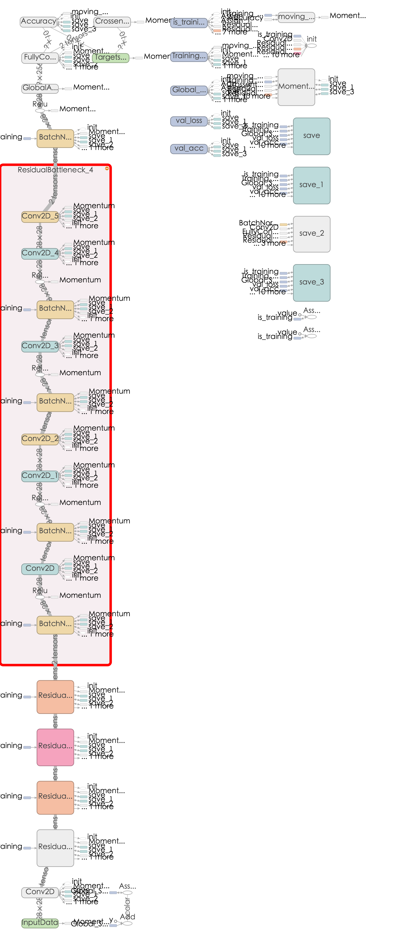
Deep Residual Network
Notes:
Example network architectures for ImageNet. Left: the VGG-19 model [41] (19.6 billion FLOPs) as a reference. Mid- dle: a plain network with 34 parameter layers (3.6 billion FLOPs). Right: a residual network with 34 parameter layers (3.6 billion FLOPs). The dotted shortcuts increase dimensions. Table 1 shows more details and other variants.
左图是
Tensorflow 这里有一个bug， 做downsample的时候 cpu版本是无法运行的，但是gpu是ok的

Slide 18
Tools For TensorFlow
TFlearn
TensorLayer
Keras
TF-slim
Next
Applications
Learn
Notes:
Tflearn 和tensorflow
Keras 支持theano和tensorflow为backend，看底层源码比较麻烦
TensorLayer是国人写的，整个代码架构看起来有点乱，而且关注的人比较少
tflearn
好处:1, 方便科研人员和开发人员快速配置深度网络模型；
2，方便初学者学习tensorflow代码，tf源码的api多且复杂，看tflearn的源码可以很好的学习tf的这些日常使用的api
TF-slim和Learn在官方源contrib里面不过觉着不好用

Slide 19
Deep CV Applications
Image Classification
Neural Style
Txt2Img, img2txt

Slide 20
Image Classification
Training from scratch
Retrain from pre-trained model
Load model and frozen some layers’ weights and retrain the other layers
Notes:
做一种图像分类通常有三种方法：1，从头训练某种网络结构用来进行图像识别；2，重新训练某个pre-trained model，更改类别，然后fit数据进行模型训练；3，同样是利用pre-trained model，load所有layers的参数，frozen其中某些层参数，fit数据进行模型训练。

Slide 21
Training from scratch
mnist = input_data.read_data_sets(FLAGS.data_dir, one_hot=True)
x = tf.placeholder(tf.float32, [None, 784])
W = tf.Variable(tf.zeros([784, 10]))
b = tf.Variable(tf.zeros([10]))
y = tf.matmul(x, W) + b
y_ = tf.placeholder(tf.float32, [None, 10])
cross_entropy = tf.reduce_mean(tf.nn.softmax_cross_entropy_with_logits(y, y_))
train_step = tf.train.GradientDescentOptimizer(0.5).minimize(cross_entropy)
sess = tf.InteractiveSession()
tf.initialize_all_variables().run()
for _ in range(1000):
batch_xs, batch_ys =mnist.train.next_batch(100)
sess.run(train_step, feed_dict={x: batch_xs, y_: batch_ys})
correct_prediction = tf.equal(tf.argmax(y, 1), tf.argmax(y_, 1))
accuracy = tf.reduce_mean(tf.cast(correct_prediction, tf.float32))
print(sess.run(accuracy, feed_dict={x: mnist.test.images, y_: mnist.test.labels}))
TRAIN DATA
INIT
PARAMS
MODEL
TEST
DATA
TEST
LABELS
Notes:
做一种图像分类通常有三种方法：1，从头训练某种网络结构用来进行图像识别；2，重新训练某个pre-trained model，更改类别，然后fit数据进行模型训练；3，同样是利用pre-trained model，load所有layers的参数，frozen其中某些层参数，fit数据进行模型训练。

Slide 22
Retrain from pre-trained model
Load pre params from a model file(pb，ckpt)
Change your model to the new task(class num)
Fit the train data to update the all weights
Fit your test data to inference
TRAIN DATA
PRE
PARAMS
MODEL
TEST
DATA
TEST
LABELS
Notes:
做一种图像分类通常有三种方法：1，从头训练某种网络结构用来进行图像识别；2，重新训练某个pre-trained model，更改类别，然后fit数据进行模型训练；3，同样是利用pre-trained model，load所有layers的参数，frozen其中某些层参数，fit数据进行模型训练。

Slide 23
Retrain from pre-trained model (frozen)
Load pre params from a model file(pb)
Frozen your layers’ weight
Change the network’s class num
Fit your train data to update the unfrozen layers’ weight
Fit your test data to inference
TRAIN DATA
PRE
PARAMS
FROZEN
MODEL
TEST
DATA
TEST
LABELS
https://github.com/spark-mler/WorkWithTensorflow/tree/master/cv_bot/models/pretrain_inference
Notes:
做一种图像分类通常有三种方法：1，从头训练某种网络结构用来进行图像识别；2，重新训练某个pre-trained model，更改类别，然后fit数据进行模型训练；3，同样是利用pre-trained model，load所有layers的参数，frozen其中某些层参数，fit数据进行模型训练，更新unforzen的layer，比如最后一层softmax。

Slide 24
Neural Style
MRF-Based
CNN-Based
MRF and CNN-Based
Fast Neural Style
Notes:
Neural style 是图像合成的一个经典的东西
最开始的图像合成主要是基于MRF的方法
然后 CNN, 也有MRF+CNN
然后fast neural style

Slide 25
MRF-Based
Freeman W T, Liu C. Markov random fields for super-resolution and texture synthesis[J]. Advances in Markov Random Fields for Vision and Image Processing, 2011, 1: 155-165.
Efros A A, Leung T K. Texture synthesis by non-parametric sampling[C]//Computer Vision, 1999. The Proceedings of the Seventh IEEE International Conference on. IEEE, 1999, 2: 1033-1038.
Notes:
MRF在图像分割、图像合成这块很经典的方法
Markov 随机场定义的直观意义是,xs 只受到其周围的点即Xr 的影响,而与其它的点无关“ 纹理合成所采用的 Markov Random Field (MRF)模型,是根据结果图中当前待合成像素点的邻域(或当前待合成纹理块的边界),在样本图中搜索所有像素(或纹理块),得到具有匹配邻域的像素点(或具有匹配边界的纹理块),将其作为当前待合成像素点(或纹理块)的最佳近似合成到结果图中”MRF模型认为纹理具有局部统计特征即纹理中的任一部分都可以由其周围部分(即邻域)来完全决定,这是对纹理的一种比较客观的认识“Markov 模型能够较好的刻画纹理的高阶统计特性
问题是只能考虑local的信息影响，不能再图像语义 全局上做更多的涉及

Slide 26
CNN-Based
Gatys L A, Ecker A S, Bethge M. A neural algorithm of artistic style[J]. arXiv preprint arXiv:1508.06576, 2015.
https://github.com/anishathalye/neural-style
https://github.com/jcjohnson/neural-style
Notes:
使用pre-trained的model，关键在于如何定义content loss 和style loss
Content Reconstruction: 上图中下面部分是Content Reconstruction对应于CNN中的a，b，c，d，e层，注意最开始标了Content Representations的部分不是原始图片（可以理解是给计算机比如分类器看的图片，因此如果可视化它，可能完全就不知道是什么内容），而是经过了Pre-trained之后的VGG network model的图像数据， 该model主要用来做object recognition， 这里主要用来生成图像的Content Representations。理解了这里，后面就比较容易了，经过五层卷积网络来做Content的重构，文章作者实验发现在前3层的Content Reconstruction效果比较好，d，e两层丢失了部分细节信息，保留了比较high-level的信息。
Style Reconstruction： Style的重构比较复杂，很难去模型化Style这个东西，Style Represention的生成也是和Content Representation的生成类似，也是由VGG network model去做的，不同点在于a,b,c,d,e的处理方式不同，Style Represention的Reconstruction是在CNN的不同的子集上来计算的，怎么说呢，它会分别构造conv1_1(a),[conv1_1, conv2_1](b),[conv1_1, conv2_1, conv3_1],[conv1_1, conv2_1, conv3_1,conv4_1],[conv1_1, conv2_1, conv3_1, conv4_1, conv5_1]。这样重构的Style 会在各个不同的尺度上更加匹配图像本身的style，忽略场景的全局信息。

Slide 27
MRF And CNN-Based
Li C, Wand M. Combining Markov Random Fields and Convolutional Neural Networks for Image Synthesis[J]. arXiv preprint arXiv:1601.04589, 2016
https://github.com/chuanli11/CNNMRF
Notes:
MRF model 问题：local区域的统计信息无法建模复杂图像下的全局信息，优点。
Combined MRF and CNN:
We transfer the style of x s into the layout of x_c by making the high-level neural encoding of x similar to x_c , but using local patches similar to those of x_s . The latter is the MRF prior that maintains the encoding of the style.
1，content的encode还是基于nn来做的和原来的方法一样；
2，style是采用MRF prior local patches来对style来进行编码，和neural style的方法不一样；

Slide 28
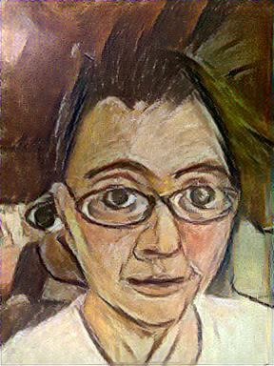
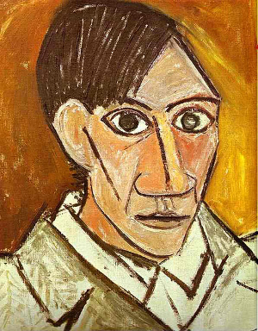

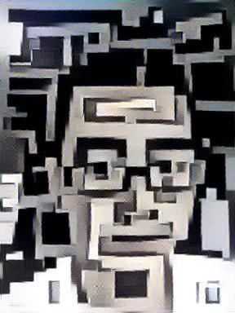

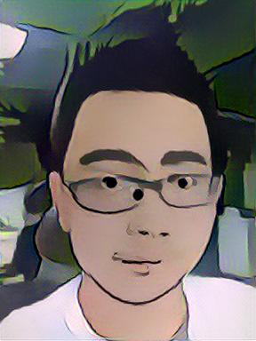

MRF And CNN-Based
Notes:
MRF model 问题：local区域的统计信息无法建模复杂图像下的全局信息，优点。
Combined MRF and CNN:
We transfer the style of x s into the layout of x_c by making the high-level neural encoding of x similar to x_c , but using local patches similar to those of x_s . The latter is the MRF prior that maintains the encoding of the style.
1，content的encode还是基于nn来做的和原来的方法一样；
2，style是采用MRF prior local patches来对style来进行编码，和neural style的方法不一样；

Slide 29
Fast Neural Style
Johnson J, Alahi A, Fei-Fei L. Perceptual losses for real-time style transfer and super-resolution[J]. arXiv preprint arXiv:1603.08155, 2016.
https://github.com/burness/neural_style_tensorflow/tree/master/fast_neural_style
Notes:
Fast neural style
image transformation network、 loss netwrok；Image Transformation network是一个deep residual conv netwrok，用来将输入图像（content image）直接transform为带有style的图像；而loss network参数是fixed的，这里的loss network和A Neural Algorithm of Aritistic Style中的网络结构一致，只是参数不做更新，只用来做content loss 和style loss的计算，这个就是所谓的perceptual loss，作者是这样解释的为Image Classification的pretrained的卷积模型已经很好的学习了perceptual和semantic information（场景和语义信息），所以后面的整个loss network仅仅是为了计算content loss和style loss，而不像A Neural Algorithm of Aritistic Style做更新这部分网络的参数，这里更新的是前面的transform network的参数，所以从整个网络结构上来看输入图像通过transform network得到转换的图像，然后计算对应的loss，整个网络通过最小化这个loss去update前面的transform network

Slide 30
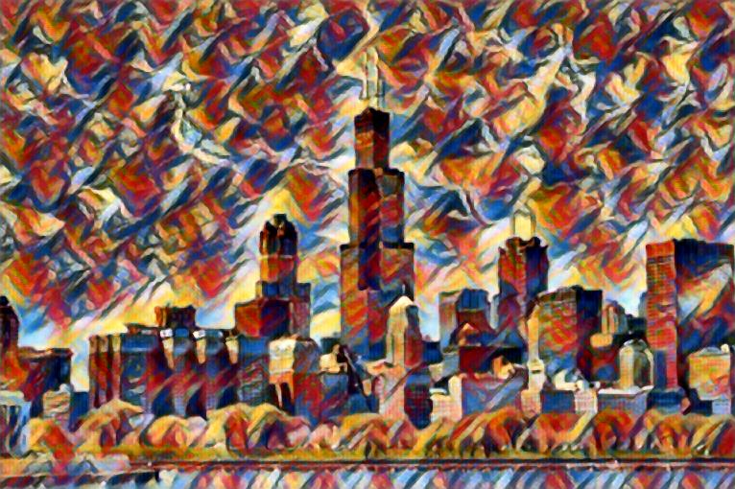
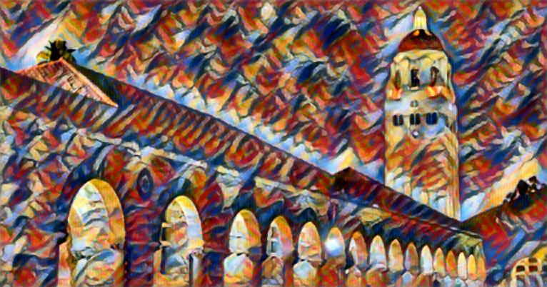
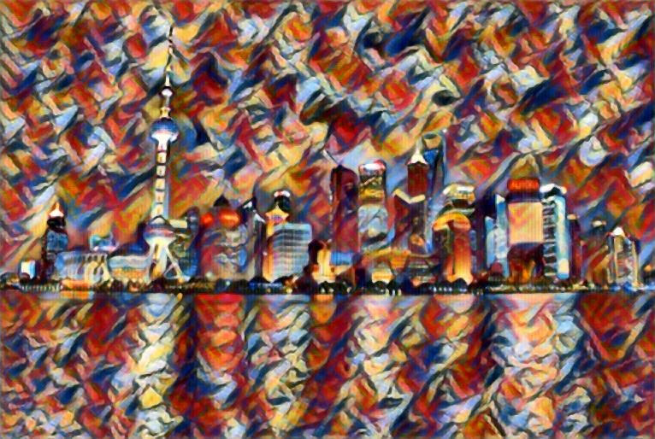
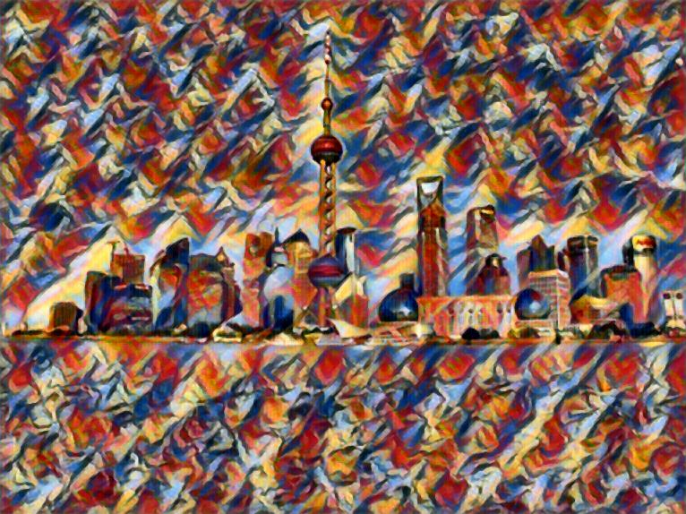
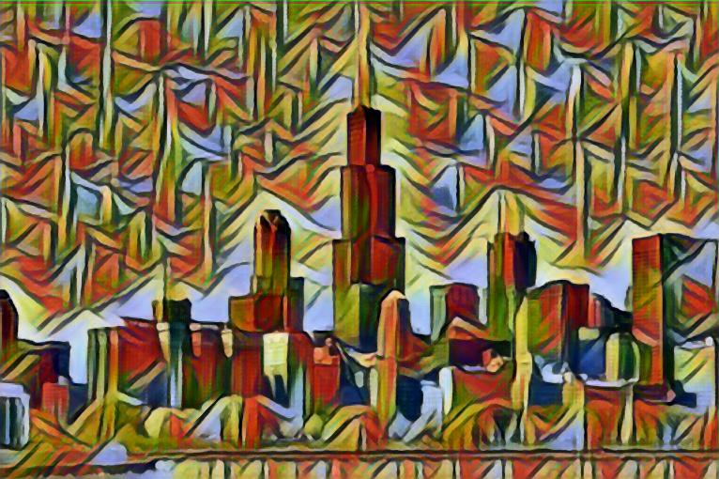
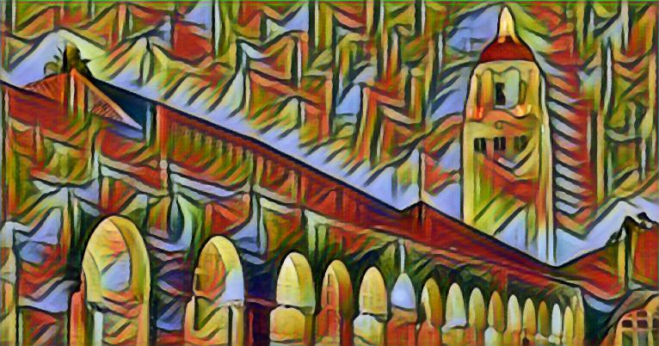
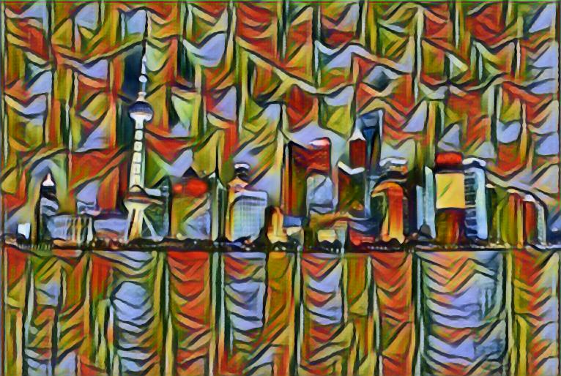
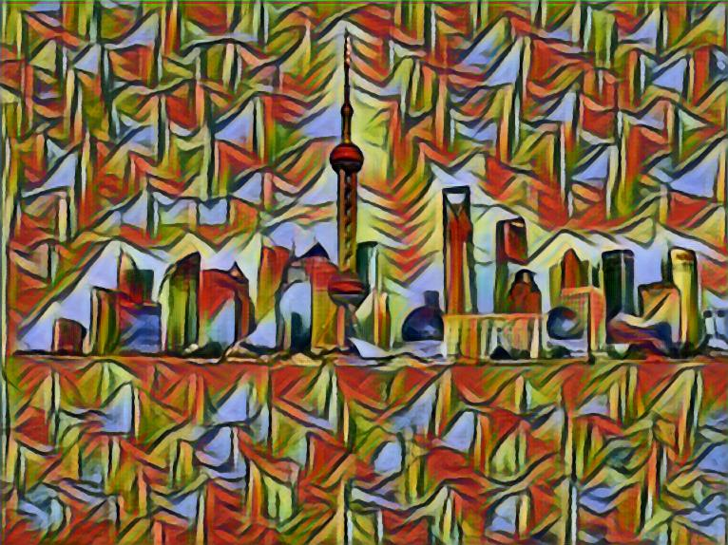
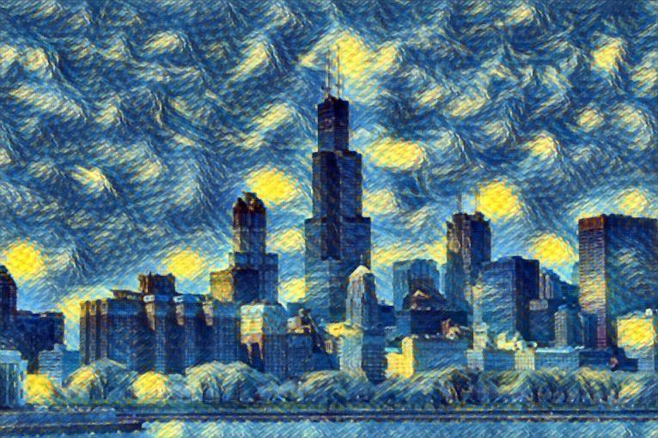
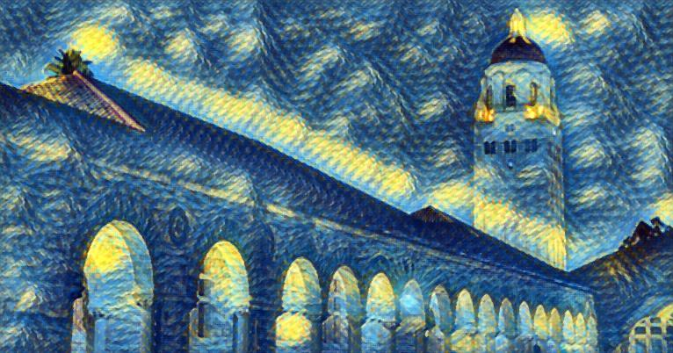
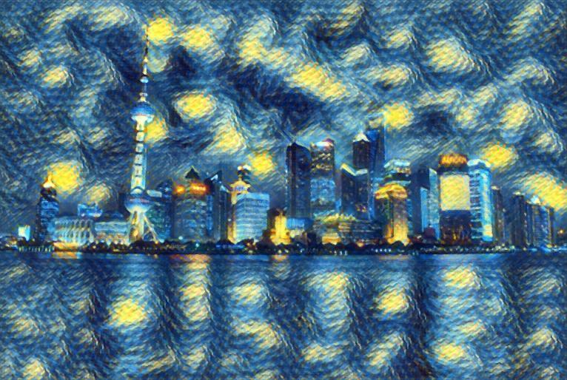
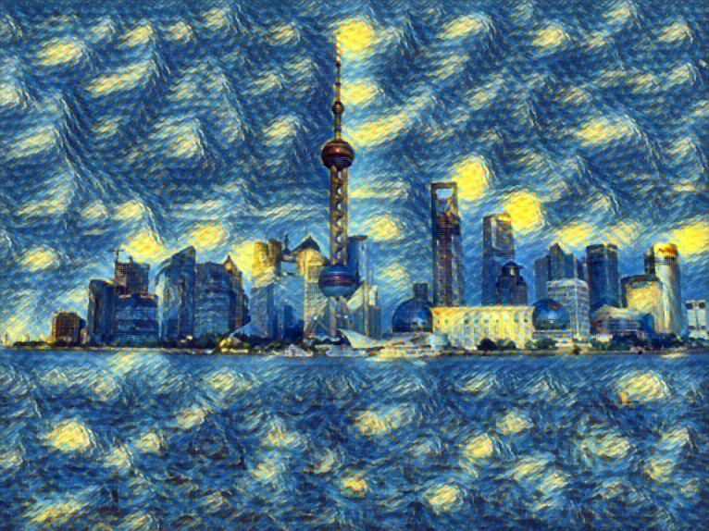
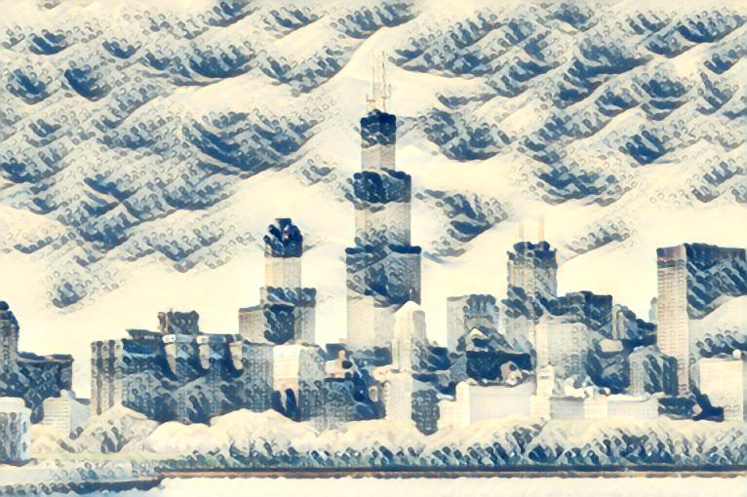

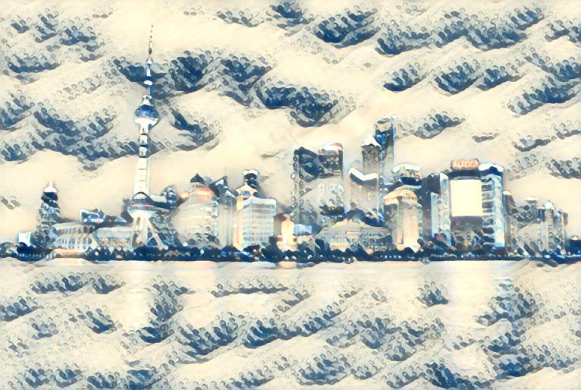
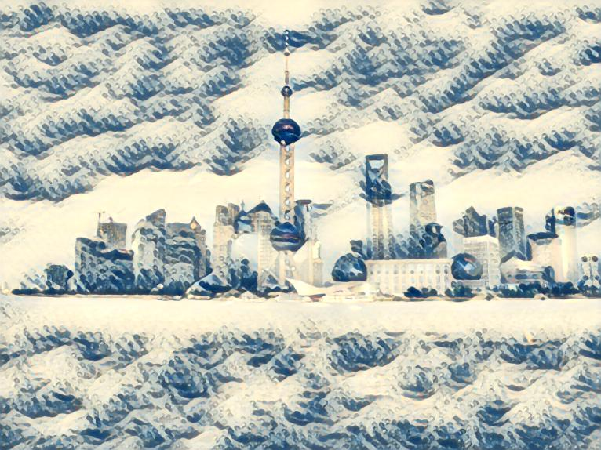
Fast Neural Style
Notes:
Chicago\hoovertowernight\sh\sh2 * [composition_vii, la_muse, starry_night, the_wave]

Slide 31
Text⬄Image
Text-to-Image
Image-to-Text
Notes:
Neural style 是图像合成的一个经典的东西
最开始的图像合成主要是基于MRF的方法
然后 CNN, 也有MRF+CNN
然后fast neural style

Slide 32
Text-to-Image
Generative Adversarial Network
Generator G and a discriminator D compete in a two-player minimax game
G: fool the discriminator
D: Distinguish real training data from synthetic images
Reed S, Akata Z, Yan X, et al. Generative adversarial text to image synthesis[J]. arXiv preprint arXiv:1605.05396, 2016.
https://github.com/paarthneekhara/text-to-image
http://www.jianshu.com/p/db87c51de510
Notes:
GAN同时要训练一个生成网络(Generator)和一个判别网络(Discriminator)，前者输入一个noise变量 z ，输出一个伪图片数据 G(z;θg)，后者输入一个图片(real image)/伪图片(fake image)数据 x ，输出一个表示该输入是自然图片或者伪造图片的二分类置信度 D(x;θd)，理想情况下，判别器 D需要尽可能准确的判断输入数据到底是一个真实的图片还是某种伪造的图片，而生成器G又需要尽最大可能去欺骗D，让D把自己产生的伪造图片全部判断成真实的图片。

Slide 33

Text-to-Image
Generative Adversarial Network
G: $ℝ^{Z}×ℝ^{T}→ℝ^{D}$
D: $ℝ^{T}×ℝ^{D}→\left\{0,1\right\}$
Notes:
Generator network用带噪声的text encoder vector（hybrid of character-level convnet with a recurrent neural network）去生成image，尽量去fool discriminator Network， Discriminator输入real/fake, learn the score as fake

Slide 34
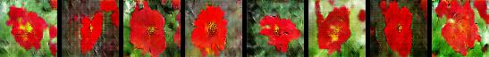
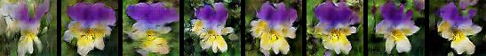
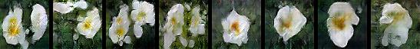
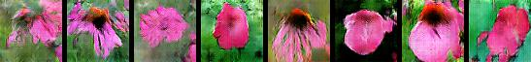

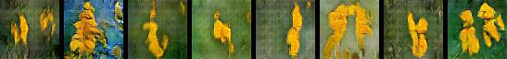
Text-to-Image
Results
the flower shown has yellow anther red pistil and bright red petals
this flower has petals that are yellow, white and purple and has dark lines
the petals on this flower are white with a yellow center
this flower has a lot of small round pink petals
this flower is orange in color, and has petals that are ruffled and rounded
the flower has yellow petals and the center of it is brown
Notes:
Ucloud gpu上跑的 300多个epoch

Slide 35
Image-to-Text
Vinyals O, Toshev A, Bengio S, et al. Show and Tell: Lessons learned from the 2015 MSCOCO Image Captioning Challenge[J]. 2016.
https://github.com/tensorflow/models/tree/master/im2txt
https://github.com/tensorflow/models/issues/480
https://github.com/tensorflow/models/pull/485/commits/c6a4f783080c5310ce0e3244daa31af57df12def
Notes:
NIC：Neural Image Caption
Bug: build with the source from github, tf.gfile error when preprocess the images to be tfrecord， fixed by using the open().
整个训练时间太长，结果还没有run出来

Slide 36
Image-to-Text
Ioffe S, Szegedy C. Batch normalization: Accelerating deep network training by reducing internal covariate shift[J]. arXiv preprint arXiv:1502.03167, 2015.
Notes:
很容易p(s_t|I, S_0,…,S_t-1)很容易被recurrent neural network建模
where θ are the parameters of our model, I is an image, and S its correct transcription.
S represents any sentence, its length is unbounded, 所以使用RNN(LSTM)
图像的表示使用CNN（batch normalization），and change the model in cvpr 15
其他细节可能需要去阅读源码，很有意思
携程之前有李健team做过这块的分享
Image cnn model batch normalization model,然后fit到lstm来进行相应nlp相关的train

Slide 37
Distributed Deep Learning In UCloud
UCloud Multi Node Weight Update
Notes:
Cmd 调用相关API驱动manage模块，启动ps/worker从UFile拿到代码和数据，然后做模型训练，训练完成后上传到ufile

Slide 38
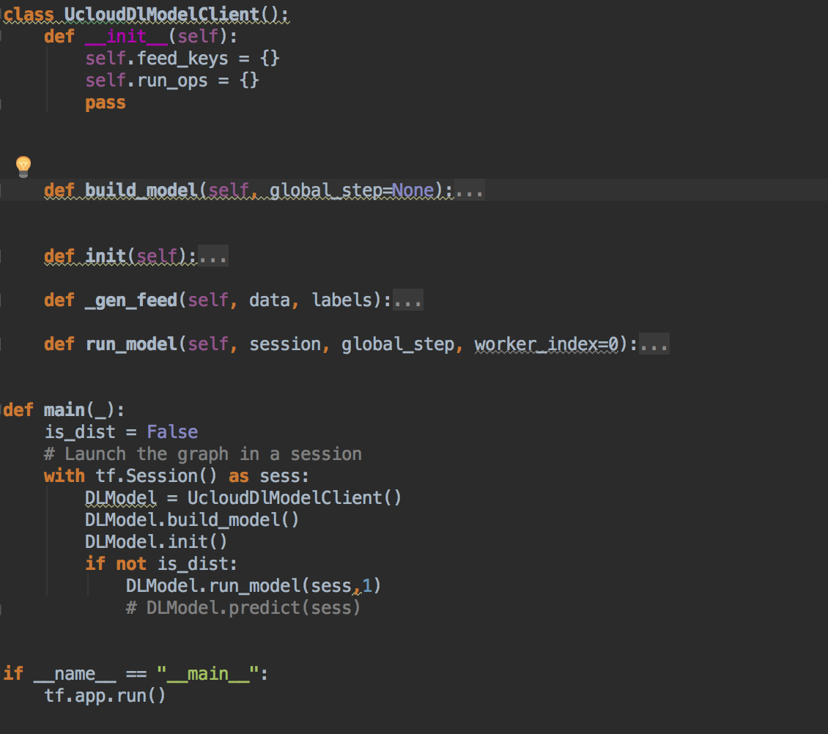
Distributed Deep Learning In UCloud
Notes:
ulcoud上如何做深度学习？
1，收集训练数据放到ufile上你的bucket下；
2，写代码：
A，主要定义代码中的build_model；
B，定义如何运行model，run_model;
3，本地测试是否能run起来；
4，上传代码，启动线上多机并行化job

Slide 39
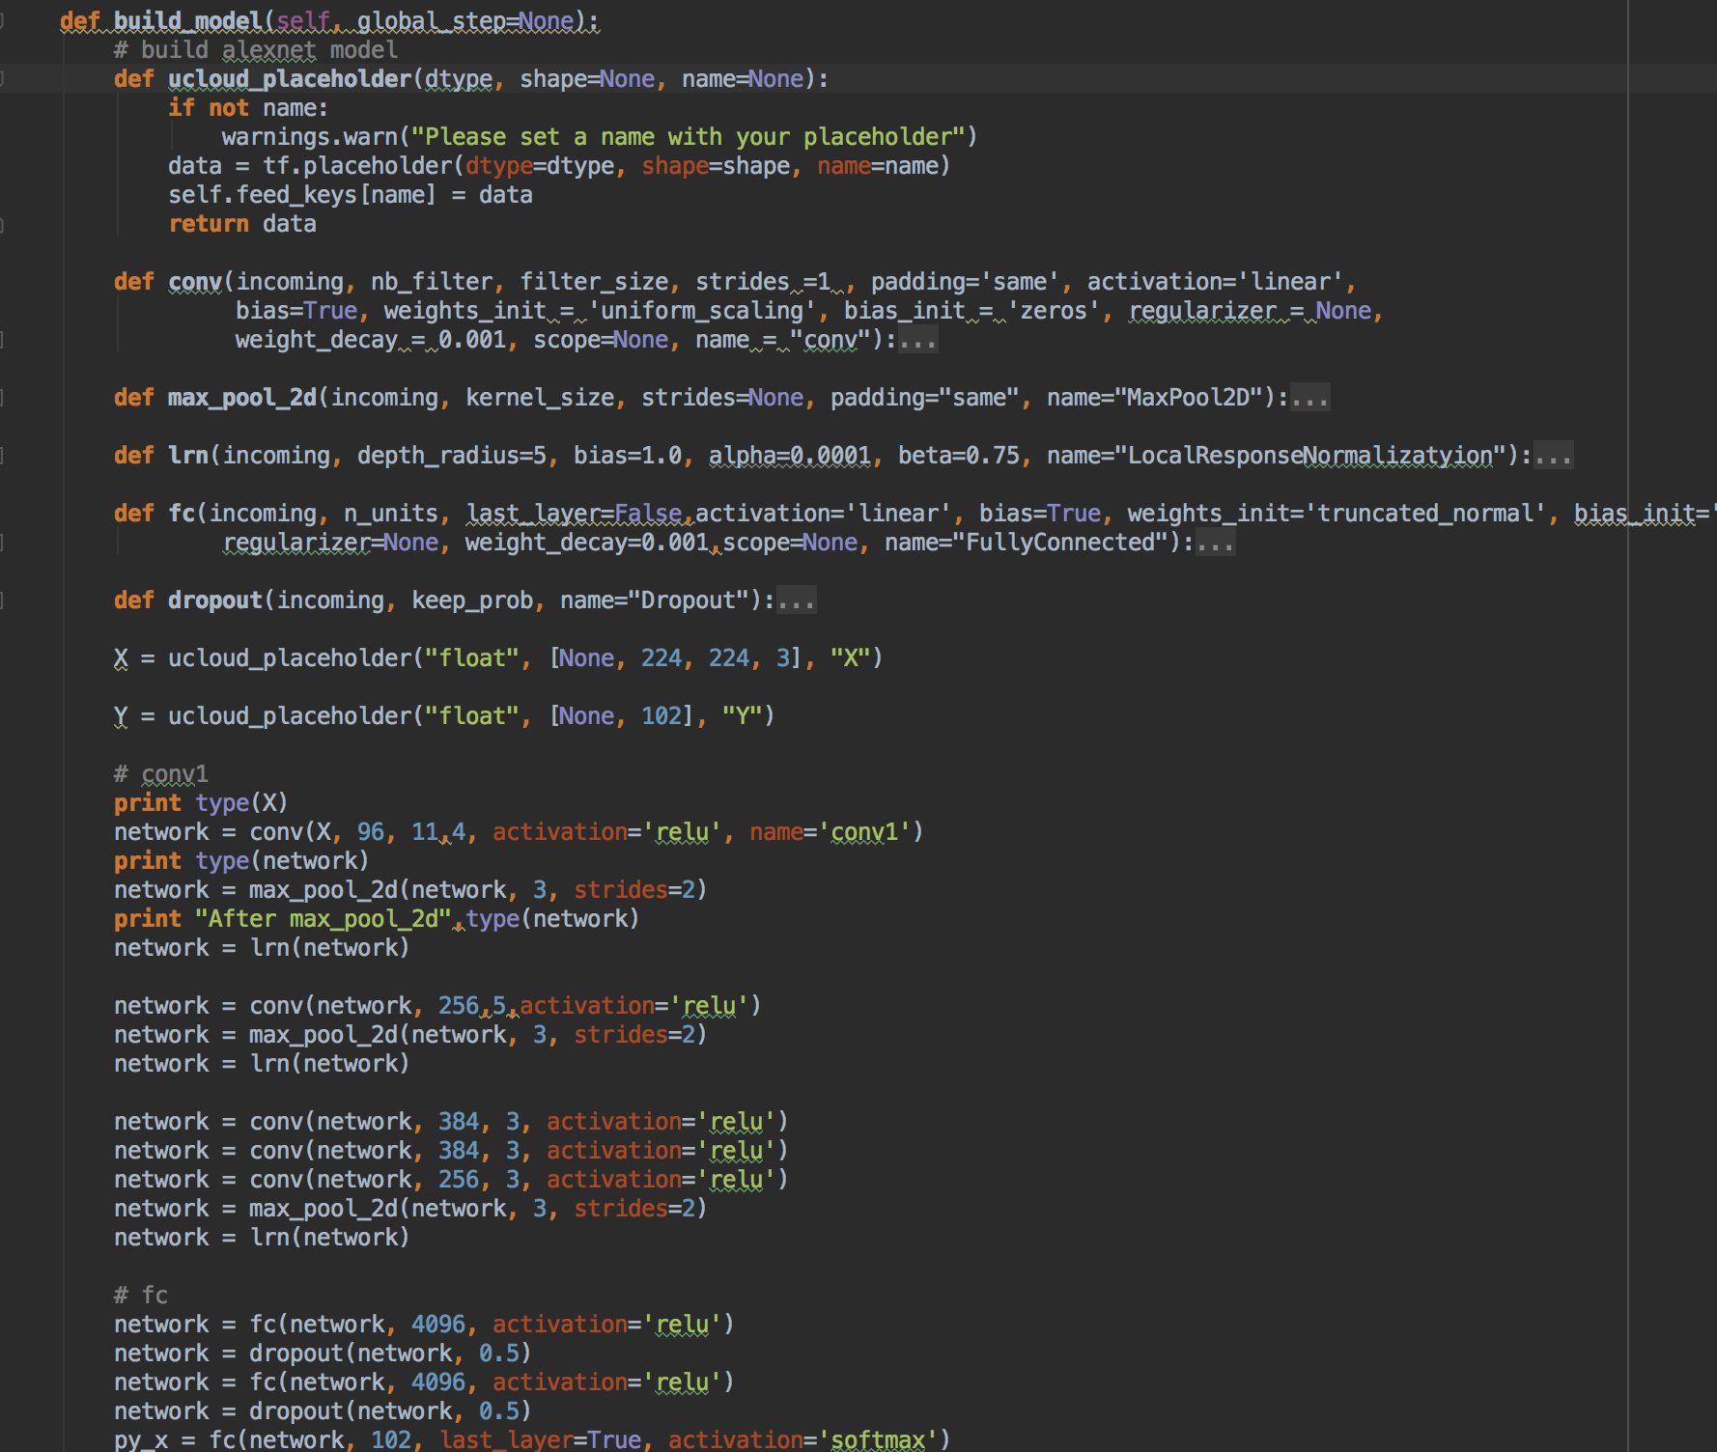
Distributed Deep Learning In UCloud
Notes:
ulcoud上如何做深度学习？
1，收集训练数据放到ufile上你的bucket下；
2，写代码：
A，主要定义代码中的build_model；
B，定义如何运行model，run_model;
3，本地测试是否能run起来；
4，上传代码，启动线上多机并行化job

Slide 40
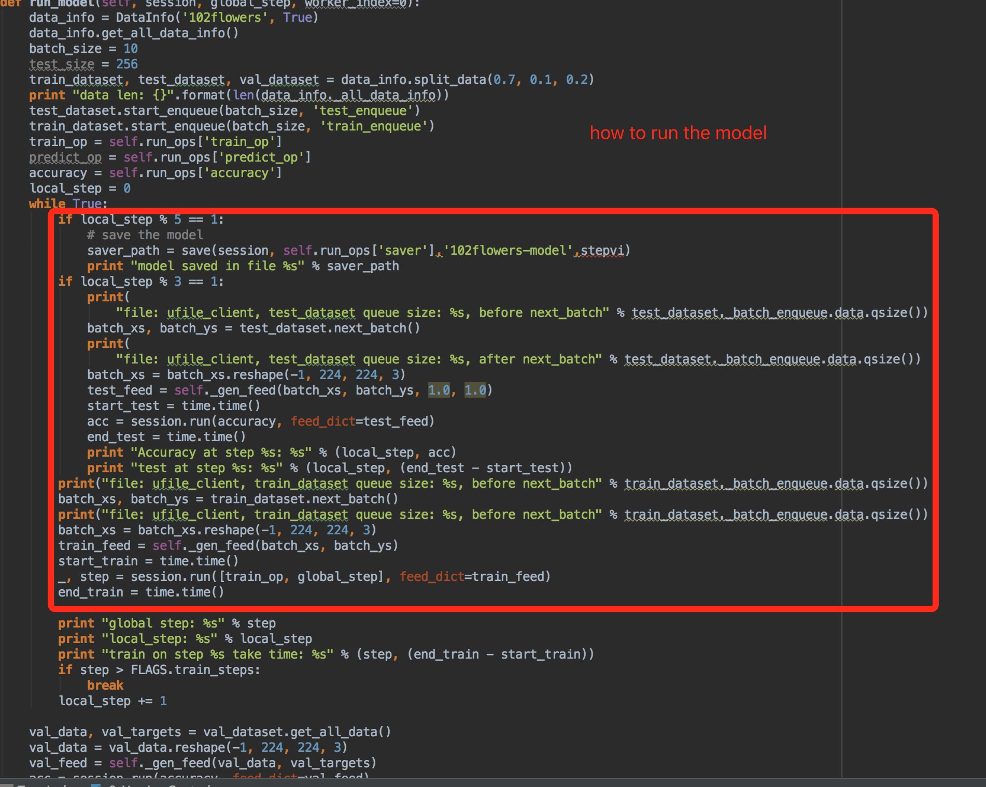
Distributed Deep Learning In UCloud
Notes:
定义如何run model，

Slide 41
Future
GAN On CV
DL On NLP
Distributed TF With Cloud
Notes:
定义如何run model，

Slide 42
Thanks
&
QA

